Slide 1
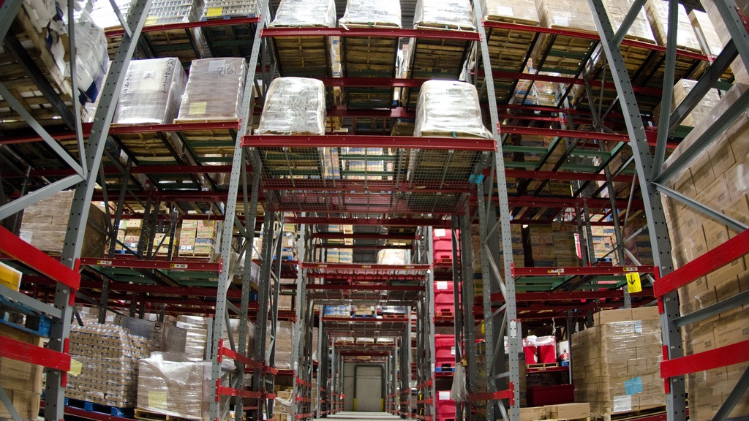
The Food Bank Fix
Sustainable Agriculture and Food System Funders Network
October 22nd, 2020
Joshua Lohnes
Food Policy Research Director
West Virginia University – Center for Resilient Communities

Slide 2
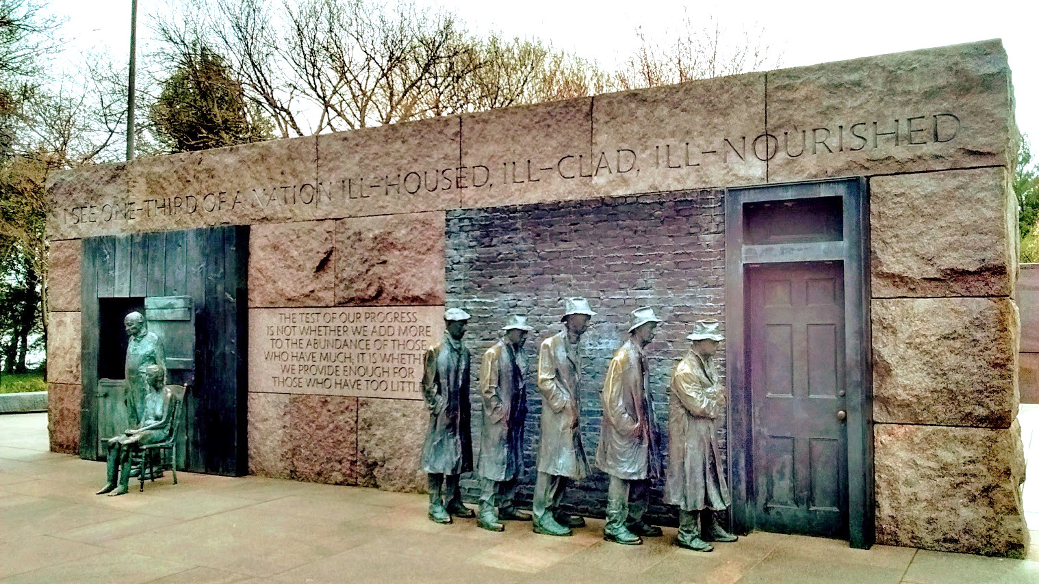

Slide 3
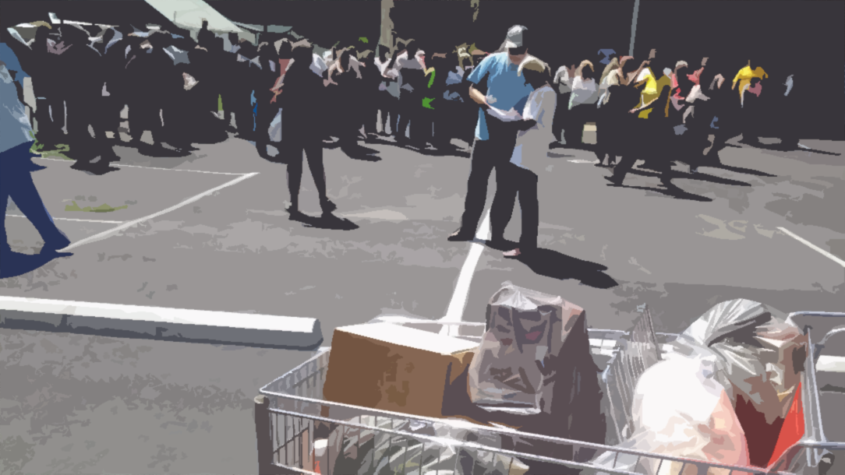

Slide 4
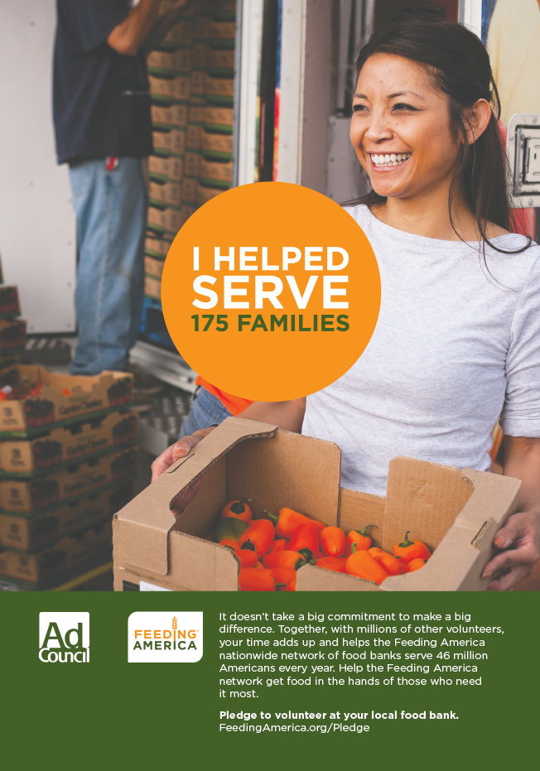

Slide 5
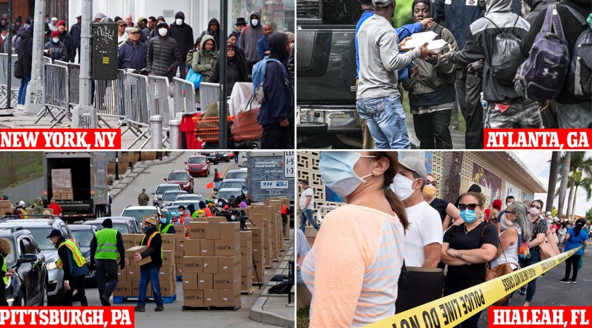
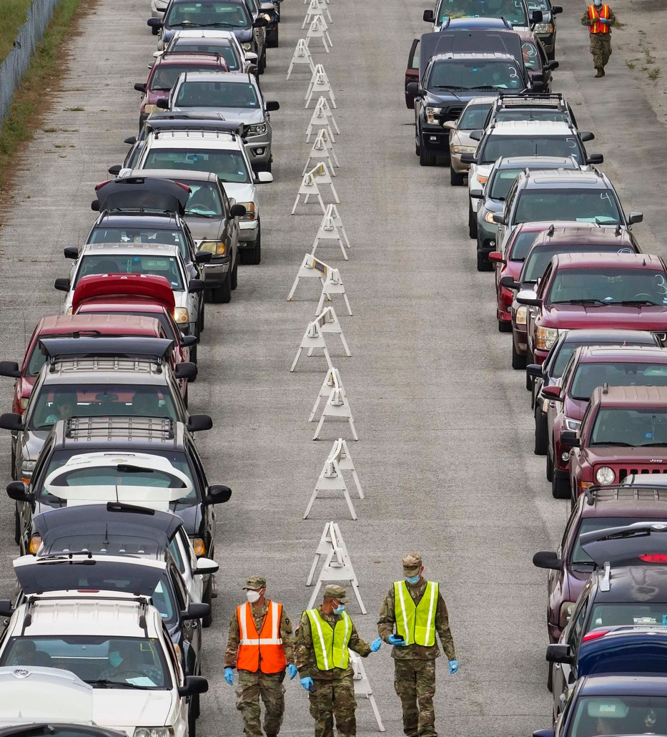
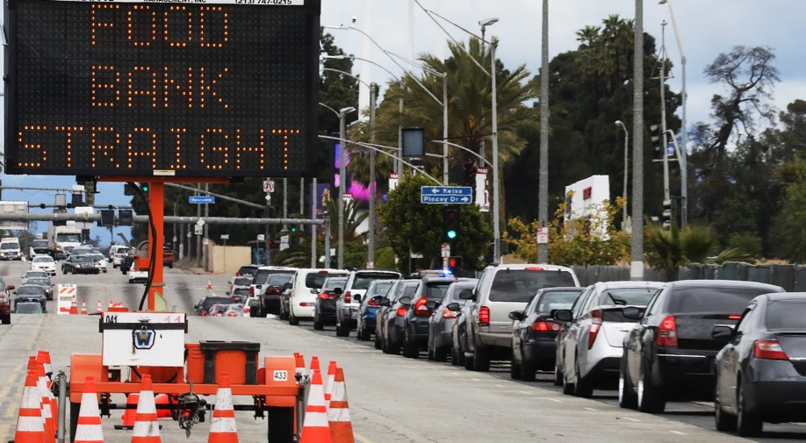

Slide 6
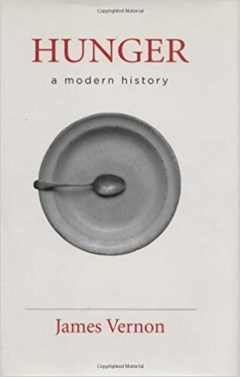
Hunger is Political!
“The struggle to define and regulate hunger produced its own networks of power, its own political constituencies, its own understanding of the responsibilities of government, and its own forms of statecraft” p.8
Notes:
I also draw on James Vernon and Mike Davis to understand the relationship between vulnerabilities to hunger and capitalism. Hunger is of course not exceptional to capitalism but very much a part of it.

Slide 7
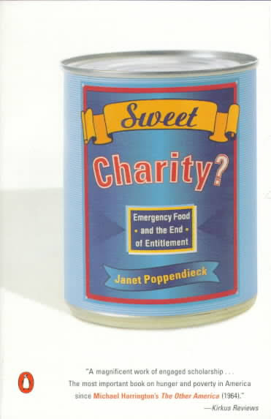
Food Charity’s Institutionalization
“This phenomenon became institutionalized because it fit so well into the agendas of other powerful institutions, particularly government and business” p.140

Slide 8
A Supply Side Expansion
Notes:
Pause and work through the graph.

Slide 9
PARTNER NETWORK
Source: http://feedingamerica.org

Slide 10
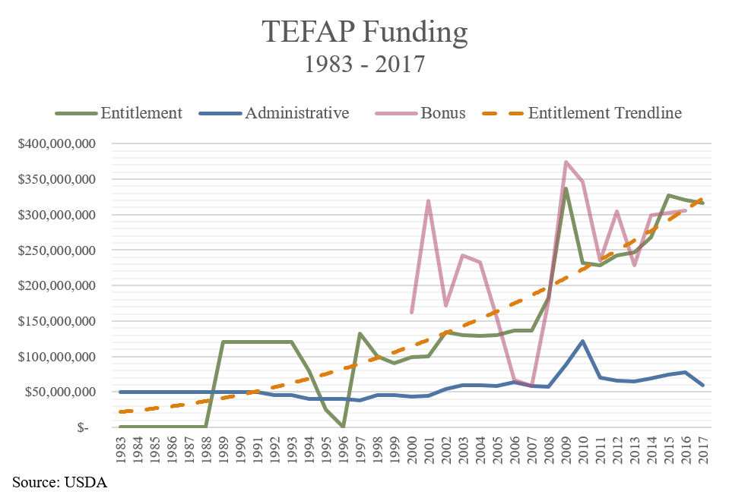
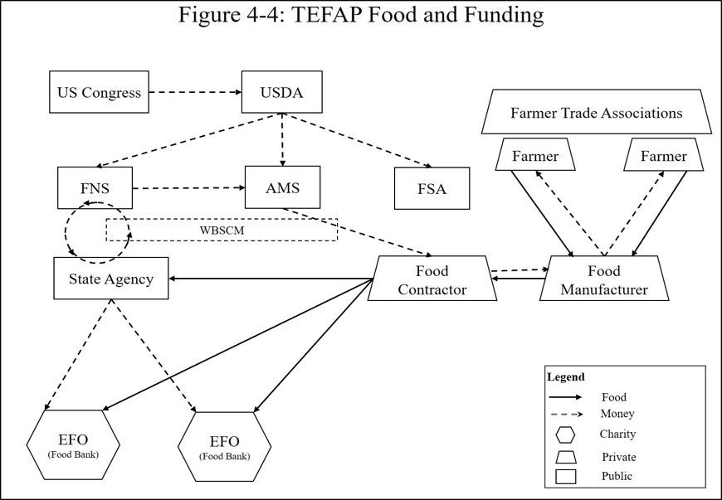
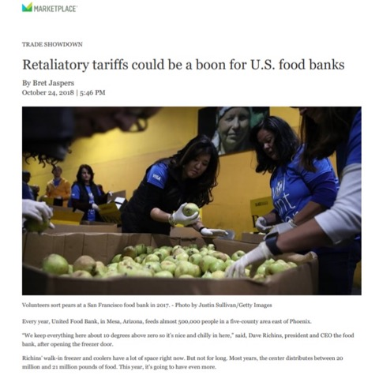
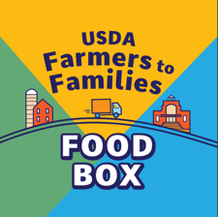
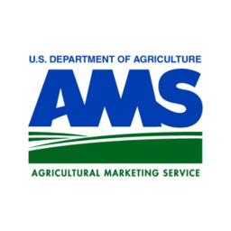
TEFAP structure
COVID-19 Response:
$2.5 billion for TEFAP
$3 billion for Farmers to Families Food Box program

Slide 11
Is it the philanthropic community’s role to subsidize the food waste distributions?

Slide 12
What are we supporting when we provide funding directly to food charity?

Slide 13
What about Ending Hunger? Rewriting the call to charity toward food justice

Slide 14
A Hunger Relief Patchwork
2 Food banks
550 local food charities
20,000,000 pounds of Food distributed
350,000 people served (20% of population)
63% USDA – TEFAP agencies
70% Faith based agencies
$9,000,000 raised/year network wide
7,000 volunteers/month
Author: Joshua Lohnes Data Source: WV FOODLINK

Slide 16
