Slide 1
Food Banking and the Right to Food
Robert Ojeda

Slide 2
Over 40 years of hunger relief
One of the largest food banks in the Feeding America Network
Distributed over 10,000 food boxes. Now 264,000 food boxes a year.

Slide 3
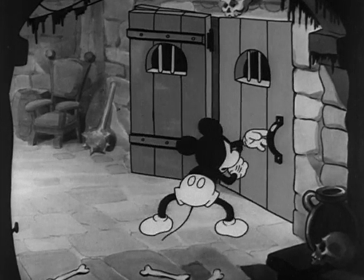
Moving from Charity to Justice
51 Years of Food Banking
#arewedoneyet?

Slide 4
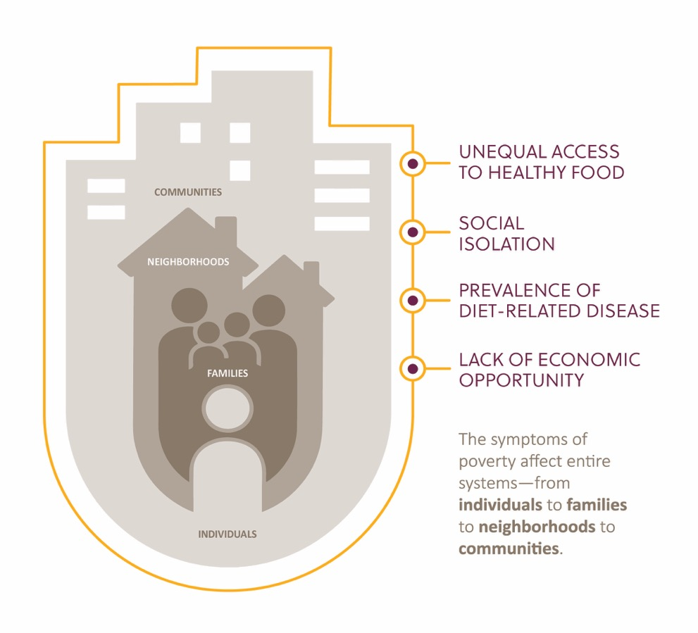
Opportunity Areas
Problems

Slide 5
Shifting the Sourcing Model
This Photo by Unknown Author is licensed under CC BY-NC
This Photo by Unknown Author is licensed under CC BY

Slide 6
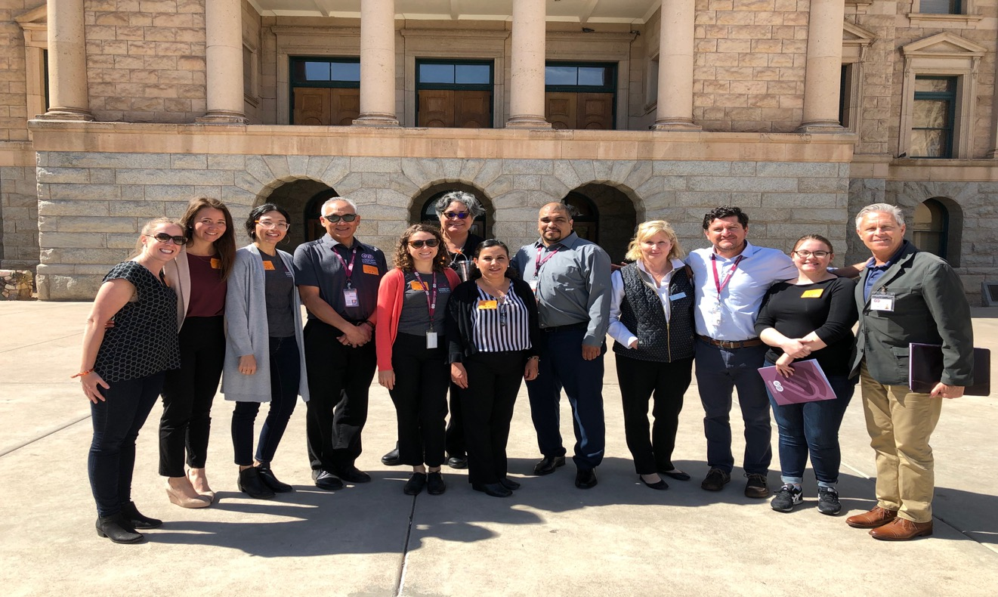
Civic Engagement

Slide 7
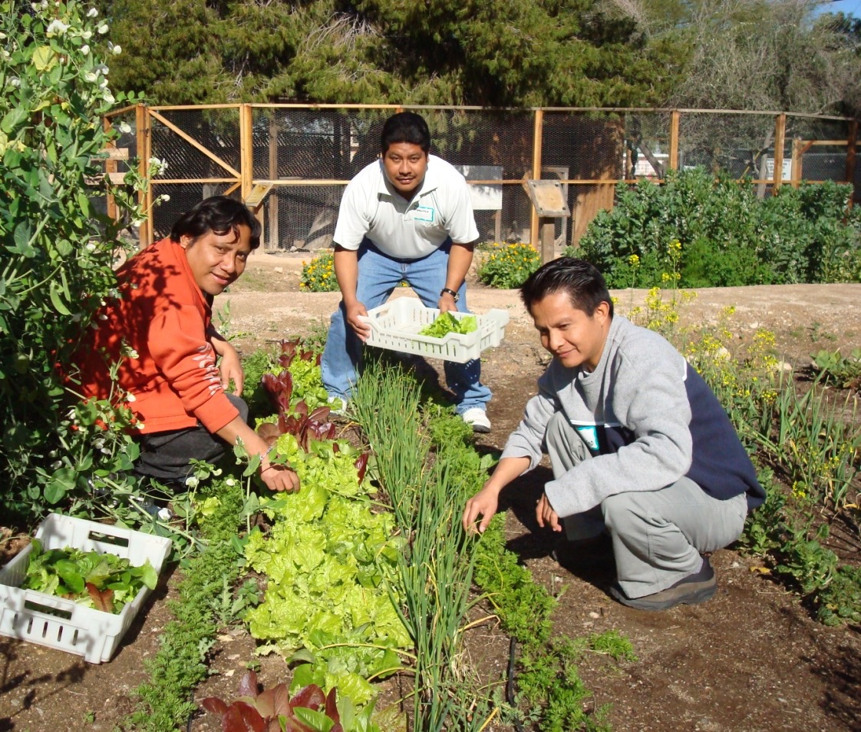
Capacity Building

Slide 8
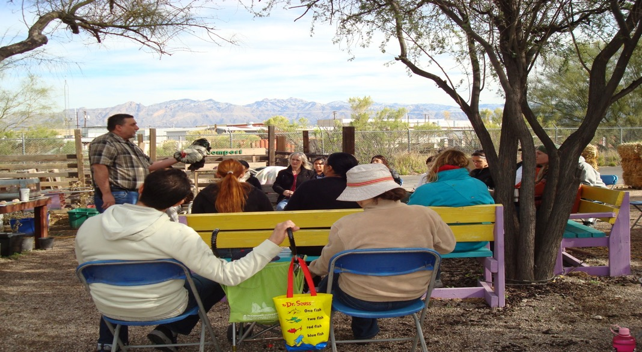
Cooperative Development

Slide 9
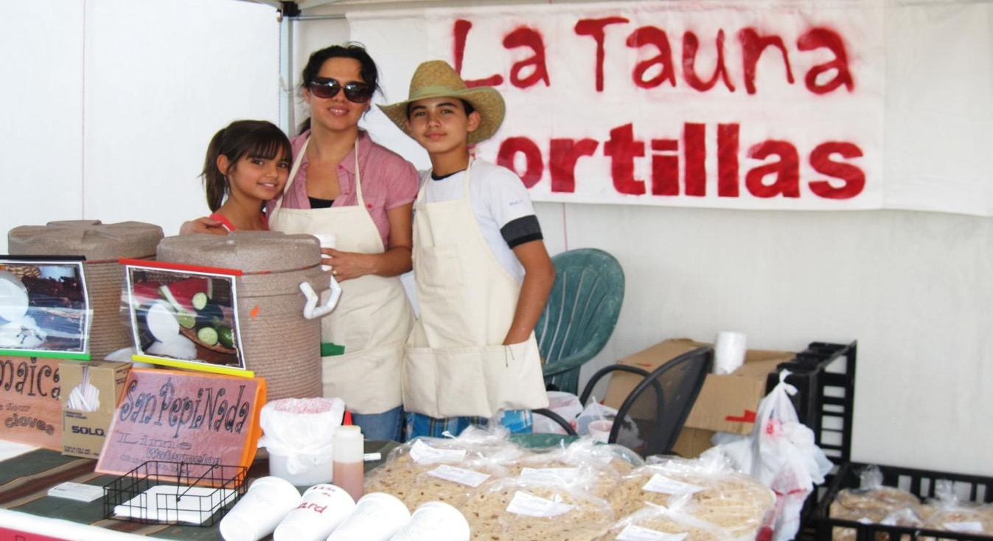
Local Food Economy

Slide 10
