Slide 1
Building a more equitable Future for u.s. agriculture
Presentation for safsf by
vANESSA garcia polanco
The National young farmers coalition

Slide 2
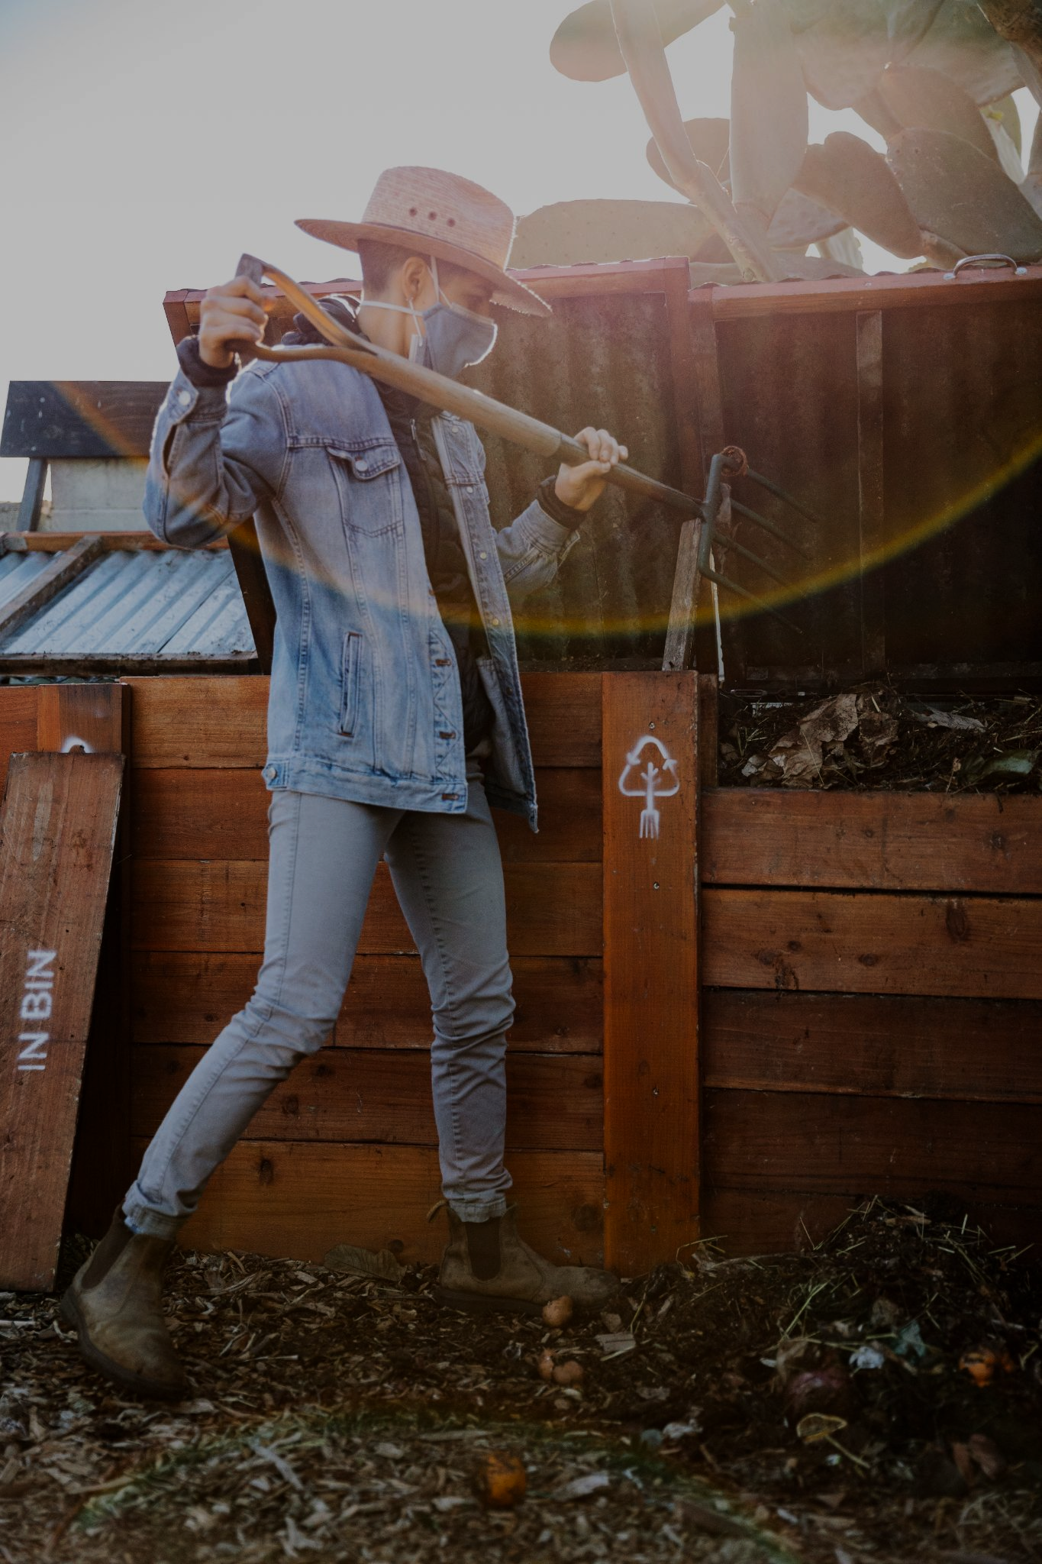
Who we are
We are farmers and ranchers who steward the struggle to transform agriculture.
We are an intersectional coalition that works for justice and collective liberation of our food and farm systems.
We champion policies that resource connections to the land and foster our health in the face of climate crisis.
We advocate for policies that recognize farming as a public service.
We work in partnership with social justice movements for a future in which people, land, and relationships are respected.
We aspire to stand in ever greater solidarity with global movements that advance human rights - especially the right to food and place.
WE BELIEVE WE HAVE ONE GENERATION TO TRANSFORM AGRICULTURE IN SERVICE TO OUR COMMUNITIES AND THE LAND.
// WE ARE THAT GENERATION.

Slide 3
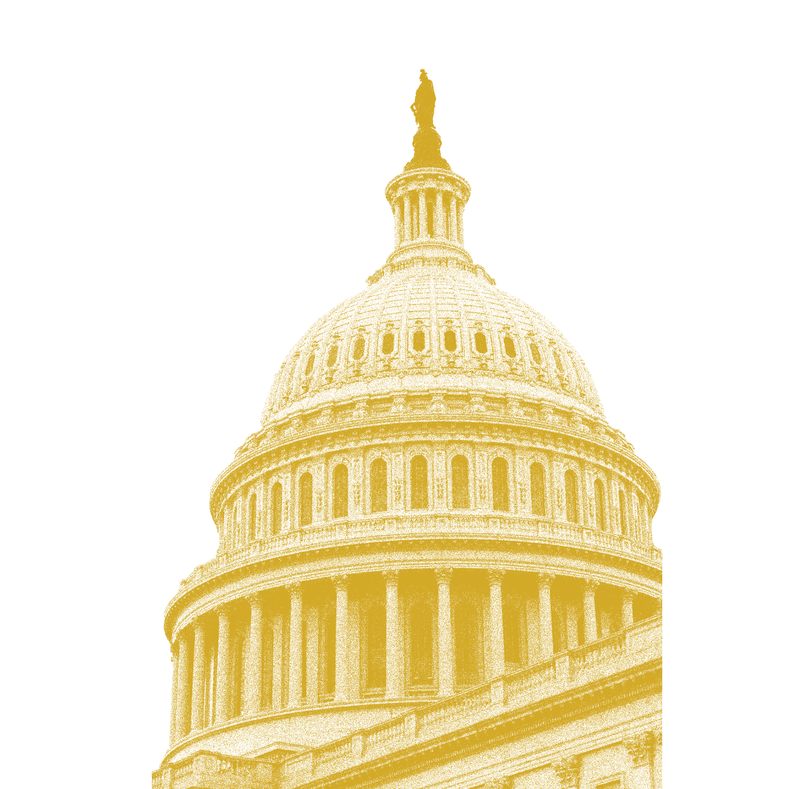
//mission
//vision
The National Young Farmers Coalition shifts power and change policy to equitably resource our new generation of working farmers.
We envision a just future where farming is free of racial violence, accessible to communities, oriented towards environmental well-being, and concerned with health over profit.

Slide 4
About our coalition
Our coalition formed in 2010 to create a unified voice for the future in federal farm policy conversations. In the last decade we have advocated for policies that have:
Created a microloan program at USDA
Secured historic funding for beginning farmer training and outreach to farmers of color
Provided millions of dollars for farmland protection
Invested in farmer mental health services
Provided accessible COVID relief, and more.
Our latest Strategic Plan answers the call of our farmers for bold, structural change. It draws on our success influencing the last two farm bills and prioritizes the 2023 farm bill as a key intervention necessary for realizing our vision of a just agricultural system.
Racial equity is the baseline for all of our policy proposals - if a policy does not center the needs of farmers of color, it exacerbates the inequities in agriculture.

Slide 5
our reach
48 Farmer-led Chapters in 31 states
Young Farmers’ chapters are the heart of our grassroots network. Our chapters are farmer-led groups that boost morale among new farmers, facilitate friendships and business partnerships, and offer an organizing platform for tackling barriers on the local, state, and national level.
3,000+ Dues-paying members
44 Staff
69.2K Followers on Instagram
75K Followers on Facebook
19K Followers on Twitter
25K Newsletter Subscribers

Slide 6
The 2023 Farm Bill is Largest Piece of Legislation shaping food and agricultural policy for the U.S.
Package of bills that will shape the future of land access, climate action, labor justice, and student loan debt relief for young farmers
40% of land will transition in the next two decades
⅔ of American Farmland will be out of production in the next twenty years if we don’t act now
This is our moment to shape the future of farming in the U.S. to be accessible to communities, oriented towards environmental well-being, and concerned with health over profit.

Slide 7
land
Access to land is the number one challenge facing the next generation of farmers, and this barrier is even greater for BIPOC farmers. We are calling on Congress to make a $2.5b investment for equitable land access in the farm bill through our One Million Acres for the Future campaign.
CLIMATE
Young farmers and ranchers are on the frontlines of the climate crisis, and urgently need concerted policy action. They need policies that encompass the depth of the climate crisis, the possibility of climate resilience, and that support both vibrant agricultural communities and healthy watersheds.
USDA ACCESS & ACCOUNTABILITY
Federal programs are failing to reach and support the next generation of farmers and ranchers. We are calling on the USDA to improve the customer experience for young and BIPOC farmers, modernize and streamline processes, provide technical assistance, and ensure programs and outreach are culturally responsive to young and BIPOC farmers.
Check out our Young Farmers Agenda for more details about our farm bill priorities.

Slide 8
STRATEGY
Our strategy is proven. Young farmers are their own best advocates. We win when they share their experiences with those in the position to help them.
ORGANIZING
We focus our organizing in districts and states with representation on the House and Senate Agriculture Committees. Our field organizers in key states are aligning farmers with our theory of change and building strong networks ready to take action.
ADVOCACY
Through our fellowships and trainings, we support farmer leaders to build strong relationships with their Members of Congress, speak powerfully to the press, and mobilize their communities to take action.
COMMUNICATIONS
We amplify young farmer stories using earned media and strategically timed communications. Our last farm bill campaign made front page news at the Washington Post - securing key visibility for our priorities at the right moment.

Slide 9
Who Are the Next Generation of Working Farmers?
80% identify as first generation farmers
86% of young farmers identify their growing practices as regenerative
97% of respondents use sustainable practices
83% of respondents named that, “one of their farm’s primary purposes is engaging in conservation or regeneration.”
For BIPOC respondents, that number is 87%. For Black respondents, that number is 88%.
88% percent of young farmers attribute changes in weather patterns they are experiencing on their farms to climate change
OUR 2022 NATIONAL YOUNG FARMER SURVEY FOUND….

Slide 10
Land ACCESS
// Access to land is the number one challenge facing the next generation of farmers in the United States, and this barrier is even greater for farmers of color.
59% of young farmers named finding affordable land to buy as very or extremely challenging
65% of BIPOC farmers ranked it as very or extremely challenging. Over half of all respondents said that they currently need more access to land, whether to buy or lease.
The 2023 Farm Bill is a critical moment for action. Along with our partners, the National Young Farmers Coalition has launched the One Million Acres for the Future campaign. We are calling on Congress to invest $2.5 billion over ten years to facilitate equitable access to one million acres of land for the next generation of farmers.
#1 CHALLENGE FOR YOUNG FARMERS

Slide 11
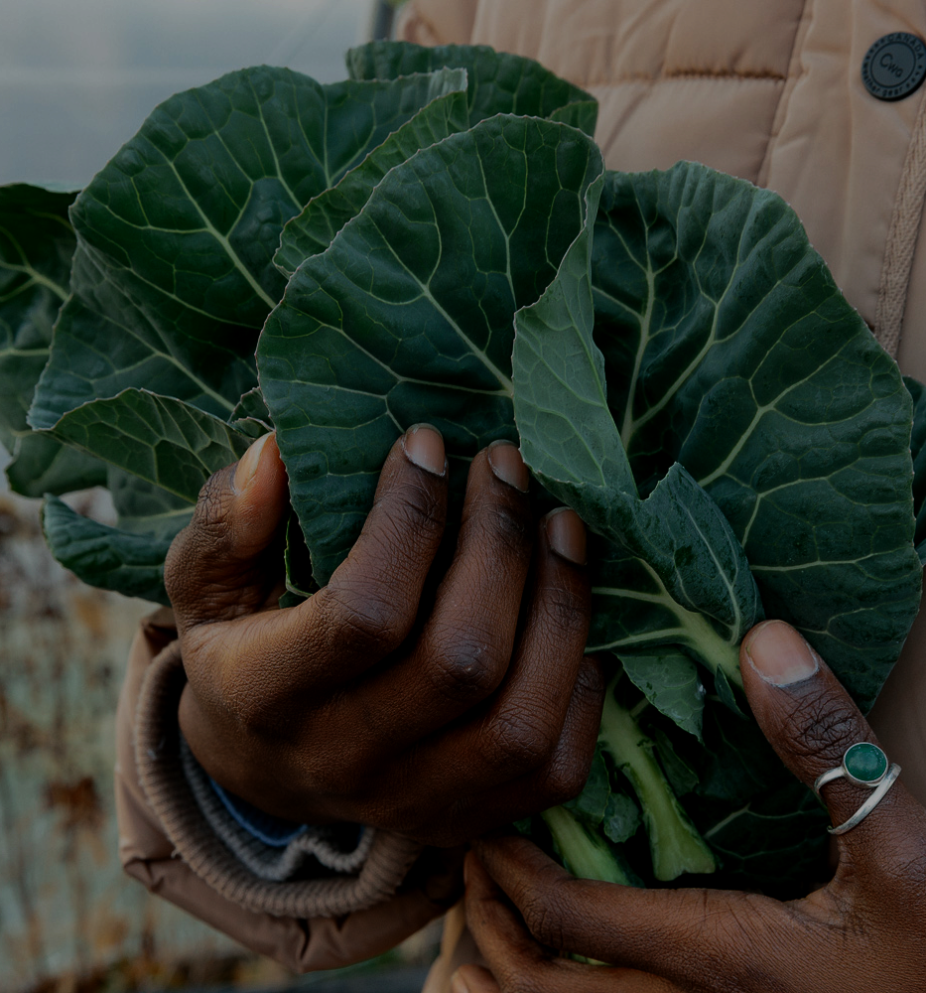
OUR FELLOWSHIPS
THEORY OF CHANGE
Land Fellowship
Water Fellowship
Food Safety Fellowship
Power in Land, Agriculture, Climate, and Equity (PLACE) Fellowship
California Political Leadership Fellowship
Young Farmers, when resourced and trained to share their stories with lawmakers can remake the food system to be more equitable, just, and in service to our communities and the land

Slide 12
events
Each year, we bring together hundreds of current and prospective young farmer leaders from across the country to learn how to be effective advocates for change. Young farmers leave our National Leadership Convergence inspired by their peers and ready to lead our coalition from the grassroots.
D.C. Farmer Fly-In
March 6-10, 2023
The 2023 Farm Bill is our greatest opportunity to deliver the change our farmers and communities deserve. We are sending 150 farmer leaders in our network to Washington, D.C. in March 2023 to meet with their members of Congress and advocate for equitable climate policy.
cLIMATE rally
March 6-10, 2023

Slide 13
Case study
Chipotle // Direct Farmer Support >> Direct Policy Action
Young Farmer Grant Program
Awarded $500,000 in grants to 100 farmers in our network - a majority are awarded to grants to Black, Indigenous, and other people of color, and cisgender women, non binary, and trans farmers.
One Million Acres Campaign
Lead sponsor of our land campaign supporting our advocacy and organizing for the 2023 Farm Bill.

Slide 14
OTHER WAYS TO GET INVOLVED
Sign on to our One Million Acres for the Future Campaign
With millions of acres on the verge of changing hands and leaving agriculture forever, the 2023 Farm Bill is our last chance to ensure this land transitions equitably to the next generation. Join us! We are building a coalition to advocate for equitable land policy change in the 2023 Farm Bill.
Join our 2023 Farm Bill Action Network
We are focused on shaping the next Farm Bill and USDA’s administrative priorities, to address the structural challenges facing this new generation of young and Black, Indigenous, People of Color (BIPOC) farmers. We are collaborating with farmer leaders, policy makers, and diverse stakeholders to envision and design a policy framework that prioritizes equitable land access and transition, and that is deeply informed by young farmer challenges and needs related to climate change, access to clean water, viability and economic justice, and immigration and labor.
In-kind donations
Corporate partners donate all kinds of resources to Young Farmers.
Other partners donate event space, snacks, beverages, COVID personal protective equipment, and more. If you have a creative in-kind donation idea, don’t hesitate to let us know!
Our 2022 Survey would not have been possible without generous in-kind donations provided by partners like Carhartt and The Original Muck Boot!

Slide 15
Get in touch to learn more about partnering with Young Farmers!
Vanessa Garcia POLANCO, polICY DIRECTOR
VANESSA@YOUNGFARMERS.ORG

Slide 16
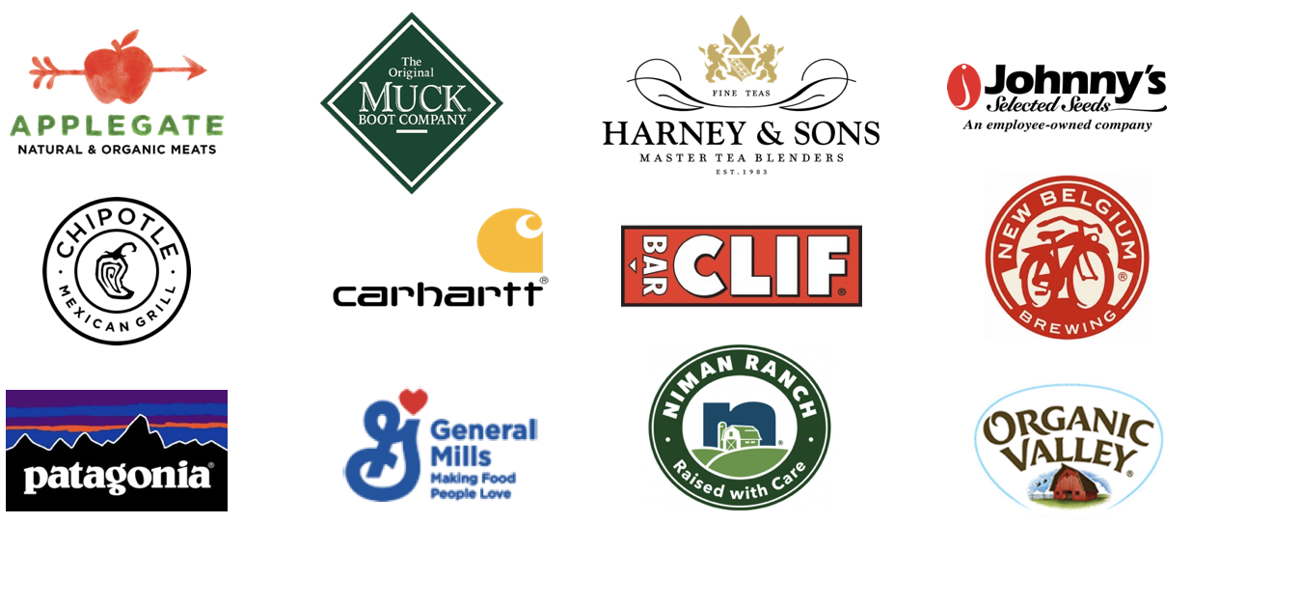
OUR PARTNERS
Young Farmers is supported by companies and brands that invest in a more resilient and equitable future for agriculture. From matching campaigns and sponsorships to deep engagements on critical issues, our partners provide critical support to Young Farmers in ways that align with their corporate values and priorities. Partners include, but are not limited to:

Slide 17
LEVELS OF GENERAL SUPPORT
BENEFITS | SEED-SOWER $5,000 | CULTIVATOR $10,000 | HARVESTER $25,000 | SHEPHERD $50,000 | Barn-raiser $100,000
Name and logo on YF Website - 1 yr
Network-wide newsletter story
Social media cross- Promotional campaign
Title sponsorship of National Leadership Convergence
Cause-marketing partnership with Young Farmers logo on product

Slide 18
Engaging with Our Members
Membership Opportunities
The National Young Farmers Coalition is farmer-driven and member-based. Our membership program creates a network of young farmers, ranchers, and supporters across the country who share resources, organize in local chapters, and advocate together for policy change.
Corporate partners can support Young Farmers by offering discounts to our member network and helping to advertise membership through their channels.
Membership discounts provide a great opportunity for companies to engage a devoted audience

Slide 19
Case study
Carhartt // so many ways to partner
In 2022, Carhartt supported our
Farm Bill Impact Fund to support big wins for land and climate as we advocate for the 2023 Farm Bill;
Regional Funding / Michigan to support organizing in Michigan, Carhartt’s home state;
USDA Access and Accountability outreach to our farmers about USDA programs, and communicate their needs back to the agency.
Young Farmers Survey outreach by providing in-kind incentives for survey participants.

Slide 20
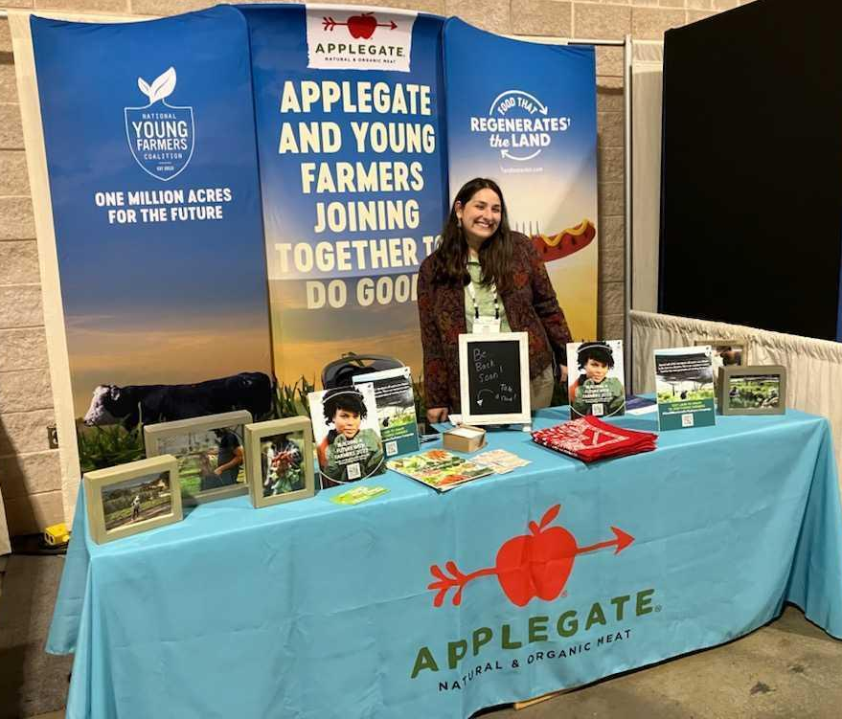
Case study
applegate
Our friends at Applegate were kind enough to invite National Young Farmers Coalition to share a booth with them at Natural Products Expo East. This enabled us to increase our engagement and connect with new audiences at a very low cost!

Slide 21
Case study
butcherbox
"At ButcherBox, we believe enabling a more diverse group of people, including Black, Indigenous and People of Color (BIPOC), to access land and humanely raise livestock can bring impactful change to the food industry. Through our partnership with the National Young Farmers Coalition, we were introduced to the BIPOC Land Fellows Technical Assistance Fund and were immediately impressed by their holistic approach to supporting BIPOC fellows. The fund, which supports the fellows’ immediate needs such as legal and financial assistance, while embracing other essentials such as mental health care, squarely aligns with our values and brand mission and is why we’re honored to contribute and support the next generation of farmers and ranchers."
-Kelly Hilovsky, Social and Environmental Impact Manager

