Slide 1
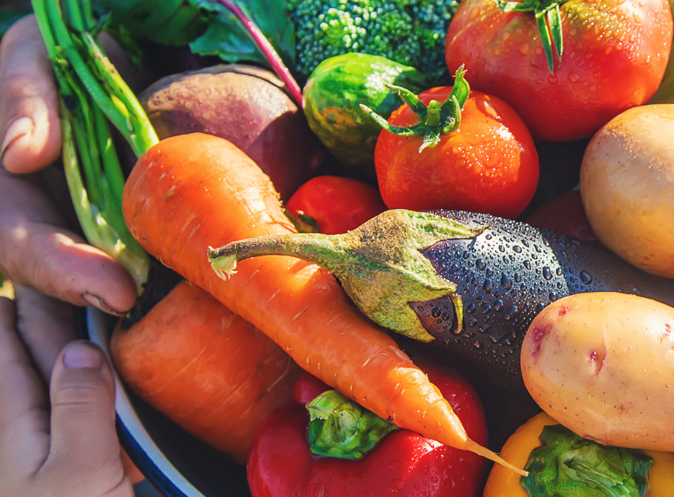
2023 Farm Bill
Improving food and nutrition security through SNAP
GIH-SAFSF Funder Call
April 19, 2023
Notes:
Welcome and introduce self

Slide 2
Agenda
CSPI Background
NANA background
Centering priorities of people with lived expertise
CSPI & NANA Priorities
Advocacy & Funding Opportunities
Questions

Slide 3
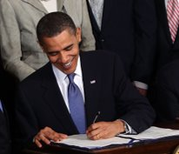
Center for Science in the Public Interest (CSPI)​
Your Food & Health Watchdog
Founded in 1971, based in Washington D.C.​
Non-profit mission: science-based advocacy and consumer education​ ​
Independent consumer voice: no corporate donations or government grants
Menu Labeling (part of Affordable Care Act)
www.cspinet.org
Notes:
Introduce CSPI: We are America’s Food and Health Watchdog, ​
​
Founded in 1971, with a non-profit mission of science-based advocacy and consumer education​
Independent consumer voice: no corporate donations or government grants which allows us to share unbiased nutrition information with the public​
As an example of our work, we were a leading force behind lobbying for school nutrition standards with the Obama administration, as well as the part of the affordable care act requiring calories on restaurant menus.​
We work across a number of nutrition issue areas, including SNAP and the charitable food system and support policy efforts on the federal and state levels, including the Farm Bill
-We also produce Nutrition Action magazine which has helped its readers sort through the noise on food and health by providing evidence-based information

Slide 4
National Alliance for Nutrition and Activity (NANA)​
Nation's largest nutrition advocacy coalition
More than 500 national, state, and local organizations
Examples of impact:
Passage of HHFKA
Increased funding for DNPAO
13-member Steering Committee:​
1,000 Days
Academy of Nutrition and Dietetics​
American Academy of Pediatrics​
American Cancer Society Cancer Action Network​
American Heart Association​
American Public Health Association​
Association of State Public Health Nutritionists​
Center for Science in the Public Interest​
National Association of Chronic Disease Directors​
National WIC Association​
Nemours Children’s Health​
International Fresh Produce Association​
UnidosUS
www.nanacoalition.org
Notes:
CSPI also co-founded and leads the nation's largest nutrition advocacy coalition. (we convene the steering committee)
NANA promotes, within the legislative and executive branches of government, a better understanding of the importance of healthy eating, physical activity, and obesity control to the nation's health and health-care costs. In addition, NANA aims to cultivate champions for nutrition, physical activity, and obesity prevention in Congress and federal agencies.
After a decade of national, state, and local advocacy to improve the nutritional quality of school foods, the NANA coalition led the successful effort to pass the Healthy, Hunger-Free Kids Act, a landmark law to improve and reauthorize child nutrition programs. The law (enacted 12/13/10) also includes a provision to get unhealthy foods and beverages out of school vending machines, a la carte lines and other school venues. This historic legislation provides more than 31 million American children with greater access to healthy school food.
NANA has led the effort to strengthen resources for nutrition and physical activity promotion at the Centers for Disease Control and Prevention (CDC). As a result of our efforts, CDC's Division of Nutrition, Physical Activity and Obesity's funding has increased from $2 million per year in FY 1998 to $55 million per year in FY 2018.

Slide 5
CSPI's Healthy Food Access Theory of Change​
CSPI envisions a future in which SNAP ensures equitable access to a nourishing food environment and equips participants with sufficient resources to achieve optimal health and well-being.
Notes:
So how does CSPI approach our farm bill advocacy? https://www.cspinet.org/sites/default/files/2022-05/CSPI_SNAP_ToC_Final.pdf
Here is our North Star statement: CSPI envisions a future in which SNAP supports people impacted by systemic inequalities by ensuring equitable access to a nourishing food environment and equipping participants with sufficient resources to achieve optimal health and well being.
You can see that advocacy is at the heart of this work, and we ultimately would like to impact healthier food environments where the healthy choice is the easy choice. We want to reduce food insecurity, and we want our efforts to improve diet quality. Our strategies to achieve this over on the left are to learn from and lift up the voices of community members, support and conduct rigorous research, and drive corporate accountability for consumer health.
CSPI has a long history of rigorous research and driving corporate accountability, but learning from and lifting up communities is a something we are trying to place greater emphasis on, especially as we head into the farm bill.

Slide 6
Community Learnings to Federal Advocacy: centering priorities of people with lived expertise
In 2021, CSPI granted funds to community-based organizations in seven states to run statewide community engagement projects:
Stakeholder discussions at statewide or regional convenings
Advisory committee of SNAP experts across the state
Focus groups/interviews with SNAP participants
Key informant interviews with SNAP experts
Final report with policy recommendations supported by a diverse set of stakeholders, including people who utilize SNAP
Notes:
CSPI’s model of statewide community and stakeholder engagement around SNAP strategies focused on nutrition and health
In 2020, CSPI became a grant making organization for the first time, and we gave 7 community-based organizations funds to run projects gathering stakeholder and SNAP participant input for strategies to address food and nutrition insecurity through SNAP. We asked that their project include these components, and many states adapted the format to fit their specific needs. For example in Texas there is a strong statewide coalition pushing for permanent state funding for SNAP fruit and vegetable incentives, so this community engagement project was a good opportunity to learn more about what participants thought specifically about incentives. And in Florida, they decided to do this work in tandem with a statewide survey to learn more broadly about the needs of SNAP participants.
These findings were pulled together into a report from each state with a comprehensive list of SNAP strategy recommendations with large consensus from all who participated in this project.
More recently we've expanded this work to US territories

Slide 7
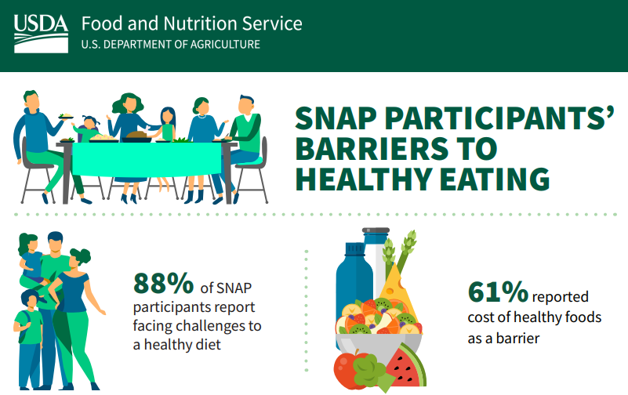
Top Recommendations
Increase monthly SNAP benefit amounts
Increase affordability of fruits and vegetables by:
Expanding SNAP incentive programs; or
Increasing SNAP benefits specifically for healthy foods; or
Providing discounts on healthy foods
Other popular strategies:
Allow SNAP to cover hot prepared meals (CO, FL, MI, TX)
Expand SNAP eligibility (AR, CO, FL)
Issue SNAP benefits more frequently (AR, FL)
Pair SNAP incentives with sugary drink disincentives (CO)
Streamline with other benefits, such as Medicaid (OH)
https://www.cspinet.org/advocacy/nutrition/healthy-snap
Notes:
Across all 6 states (one project is ongoing), (AR, CO, FL, MI, OH, TX), their top SNAP recommendations were to increase the monthly benefit amounts as many agreed that the current benefit amounts were not enough to afford the foods they need for a healthy diet. And another top recommendation was that they wanted more money fruits and vegetables. And this could be by a number of ways , including
-…
There were other popular strategies that emerged in some states...
These recommendations were largely in line with a study that came out recently from the USDA which showed that most SNAP participants face barriers to healthy eating, and the number 1 barrier is cost of healthy foods.
You'll see in a moment that CSPI adopted several of these recommendations into our organizational Farm Bill priorities. In June, our grantees and their community advocates with join us in DC for a farm bill lobby day.

Slide 8
CSPI’s 2023 Farm Bill Priorities
Top Priorities:
Increase purchasing power for nutritious foods*
Strengthen the Gus Schumacher Nutrition Incentive Program
Improve the healthfulness of retail food environments
Strengthen stocking standards
Improve access to SNAP grocery delivery
Require SNAP online retailers display the Nutrition Facts Panel clearly and consistently.
https://www.cspinet.org/advocacy/nutrition/nutrition-security-farm-bill
Notes:
These were developed based on listening sessions, political viability, our mission/vision, expertise, what to lead v support
Longer list of priorities
*indicates priorities from community learning sessions
Stocking standards – WH has called for the rider blocking USDA to strengthen them to be removed
-website with resources, including facts sheets that provide more detail and could be used for talking points

Slide 9
CSPI’s 2023 Farm Bill Priorities
Top Priorities, cont.:
Invest in research to strengthen food and nutrition security*
Invest $100 million in state-based nutrition security demonstration pilots
Establish metrics and regular reporting for nutrition security
Increase nutrition security within the charitable food system
Adopt culturally-responsive nutrition guidelines
Increase The Emergency Food Assistance Program (TEFAP) funding
Increase TEFAP Farm to Food Bank (FTFB) funding
https://www.cspinet.org/advocacy/nutrition/nutrition-security-farm-bill
Notes:
Nut Sec – USDA is already working on this, but getting it into the farm bill makes sure it gets done
Metrics & reporting just as USDA does for food security
Comprehensive nutrition guidelines are currently absent from USDA Food Distribution Programs. Requiring guidelines would correct current nutritional quality disparities among USDA programs and ensure the charitable food system is receiving health-promoting, culturally appropriate food that would better address the needs of the populations served. HER guidelines for food banks https://healthyeatingresearch.org/research/healthy-eating-research-nutrition-guidelines-for-the-charitable-food-system/
o Increase The Emergency Food Assistance Program (TEFAP) funding by indexing TEFAP to the Low-Cost Food Plan. Currently, the annual TEFAP appropriation is calculated based on changes to the Thrifty Food Plan. However, the Low-Cost Food Plan is more closely aligned with the amount that low- and moderate-income families report needing to spend on food and would allow the charitable food system to better meet clients’ needs.
Increase TEFAP Farm to Food Bank (FTFB) funding from $3.7 million to at least $25 million annually. In addition, remove the state match requirement within the TEFAP FTFB program and allow for the purchase of food. The FTFB supply chain is a key opportunity to fight hunger and increase nutritious donations while cutting food waste. The current funding is not enough to support the full extent of FTFB opportunities in each state. Allowing funds to be used for purchasing food and eliminating the match requirement can better support the participation of smaller producers and less resourced states

Slide 10
NANA's 2023 Farm Bill Priorities
Signed by:
American Heart Association
American Public Health Association
American Society for Nutrition
Association of SNAP Nutrition Education Administrators (ASNNA)
Association of State Public Health Nutritionists
Balanced
CSPI
Colorado Children's Campaign
Community Food Advocates
First Focus on Children
International Fresh Produce Association
National Association of Pediatric Nurse Practitioners
Nemours Children's Health
Pima County Food Alliance
Save the Children
Society of Behavioral Medicine
The Partnership for A Healthy Mississippi
Union of Concerned Scientists
Top Priorities:
Protect and strengthen benefit levels for and access to SNAP*
Improve the food environment by increasing equitable access to healthy food online and in store
Invest in research to improve nutrition security
Strengthen nutrition education
https://www.cspinet.org/resource/nana-2023-farm-bill-priorities
Notes:
Endorsement of these recommendations does not imply that signatories have taken a position on every recommendation
The NANA Coalition Farm Bill Subcommittee collaborated to create this set of policy priorities to advance nutrition and food security, nutrition research, and nutrition education in the 2023 Farm Bill.

Slide 11
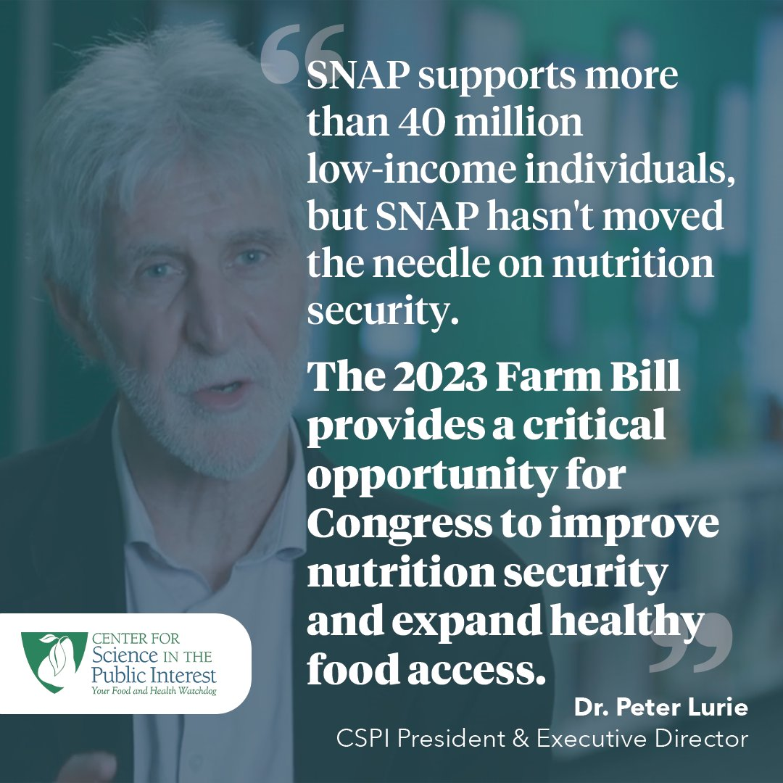
Opportunities for Advocacy
Social media
Sign-on letters
Action alerts
Join CSPI's funding partners
Notes:
-low-hanging fruit: social media and sign-on letters (CSPI can share relevant materials)
-sign-up for our action alerts (will share the link along with our slides)

Slide 12
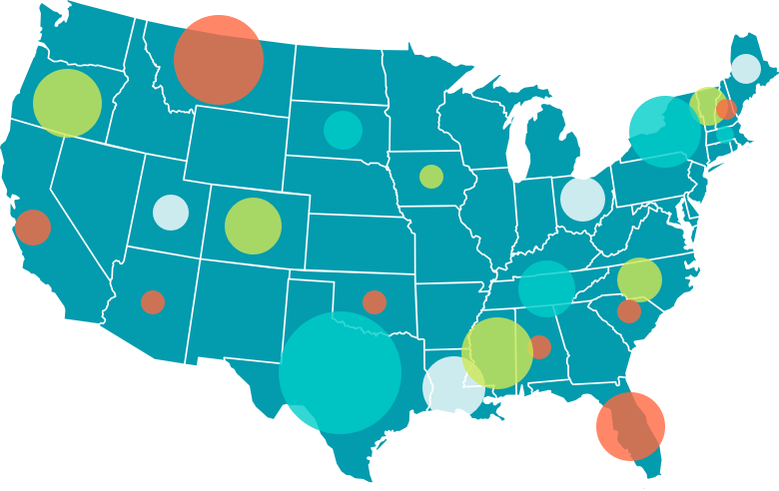
State & Local Funding Opportunities
Strengthen nutrition security in your community by funding local advocates to work with us to host stakeholder convenings that center those with lived experience. We've done so in 11 states.
Increase purchasing power of low-income families in your community by providing matching funds for state's successful GusNIP program.
Improve your retail food environment. CSPI lends technical assistance and strategic support to advocates for retail improvements that are responsive to members of state/local communities.
Underwrite a nutrition security demonstration pilot (like those in Virginia and Iowa) that can be evaluated, replicated, and scaled.
Notes:
(AR, CO, CT, FL, IA, MA, MI, NC, OH, PA, TX)

Slide 13
National Funding Opportunities
Contribute to CSPI’s campaign to nationalize a fully-funded GusNIP program so residents in all states can benefit.
Consider funding CSPI’s national campaign to strengthen stocking standards for participating SNAP retailers and better regulate on-line food sales and marketing.
Support our work to increase federal funding of TEFAP and Farm to Food Banking.
The NANA steering committee would welcome joint support from GIH and/or SAFSF members to underwrite some basic costs of this powerful alliance.

Slide 14
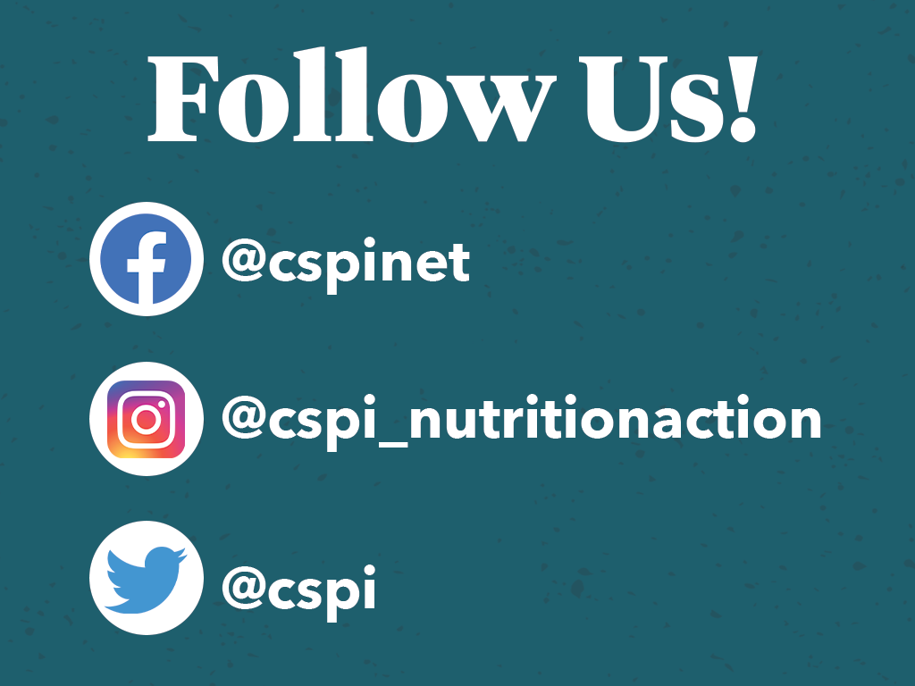
Thank you!
Joelle Johnson, MPH Healthy Food Access Campaign Manager jjohnson@cspinet.org

