Slide 1
START WITH
FOOD

Slide 2
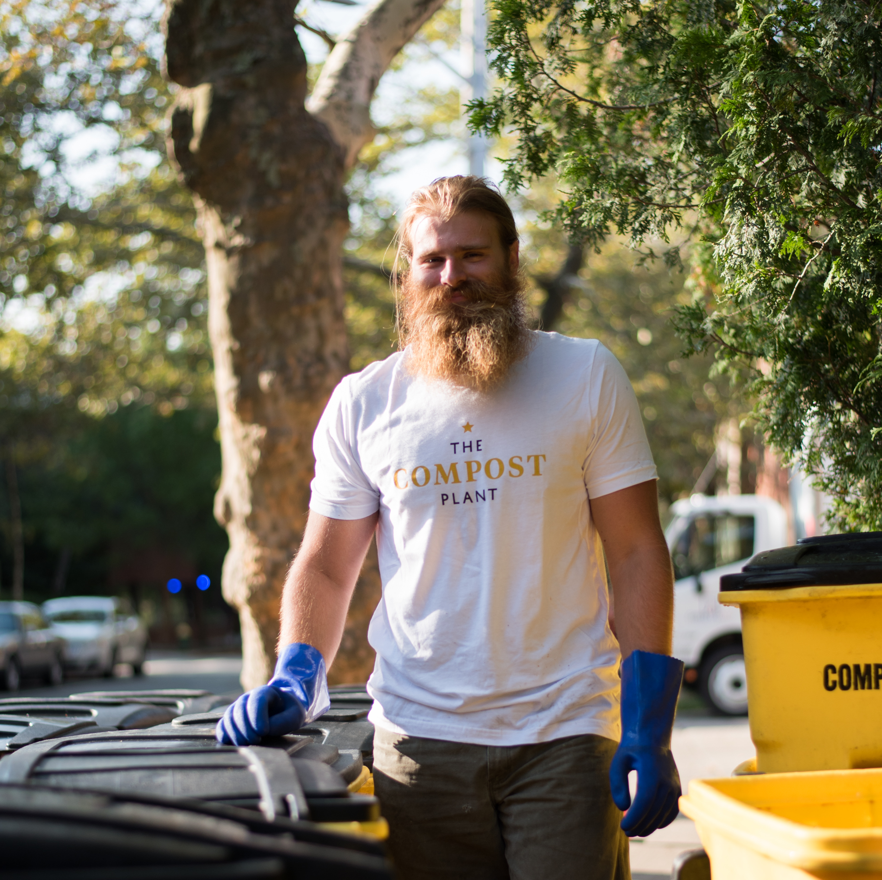
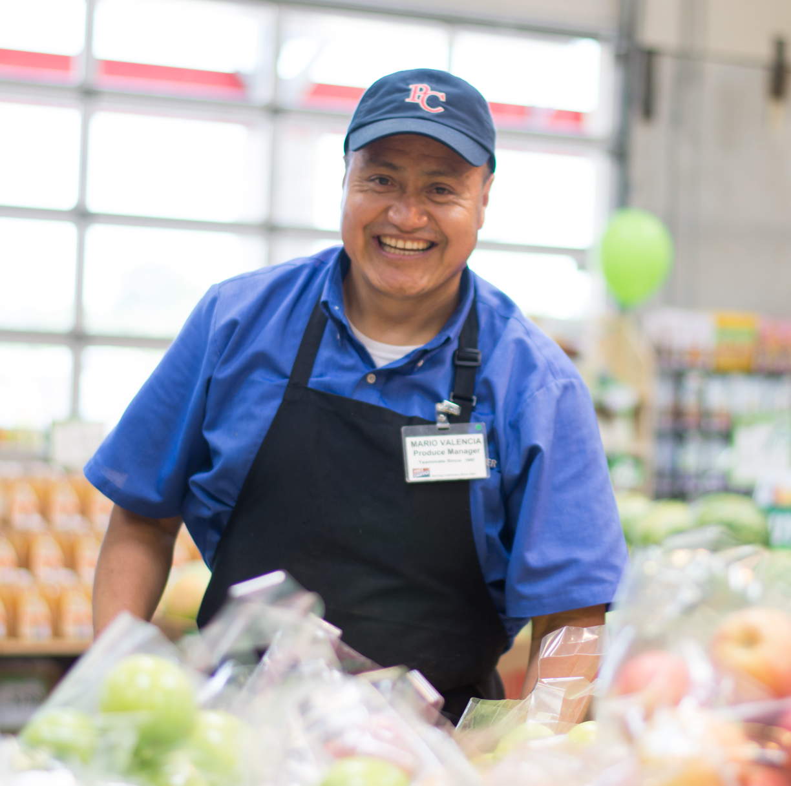
WHAT
WE DO
Financial Investing
We invest in local food organizations and businesses that provide their communities with nourishment, culture, economic opportunity, and environmental stewardship.
Capacity Building
We build collaborative relationships that strengthen our collective capacity and impact.
Policy Advocacy
We champion policies that bring proven, restorative solutions to scale across the United States.
Our approach is designed to create immediate impact and long-term systems change. Entrenched inequities have kept critical resources from being accessible to everyone. With that in mind, our work transforms how those resources—like money, political momentum, and supportive networks—flow through the food economy, building equity in communities across the country. We use three key strategies:

Slide 3
WHAT
WE DO
Nutrition Incentives
Fair Food Network builds and supports nutrition incentives that expand healthy food choices and spark economic opportunity.
Leveraging our experience and lessons learned, we lead technical assistance and innovation work that strengthens nutrition incentives and produce prescription projects nationwide.
We also advocate for policies that build up our field’s collective capacity and bring proven solutions to scale.
Impact Investing
Fair Food Network believes that food businesses are powerful engines for positive change. Farmers, grocers, and other local food entrepreneurs provide their communities with vital nourishment, economic opportunity, and environmental stewardship.
Working at the intersection of food, health, and economic justice, Fair Food Network fuels the success of food entrepreneurs through catalytic capital, wrap-around business services, and a commitment to place-based impact investing collectives.
Our efforts are currently focused in two core programs: nutrition incentives and impact investing.

Slide 4
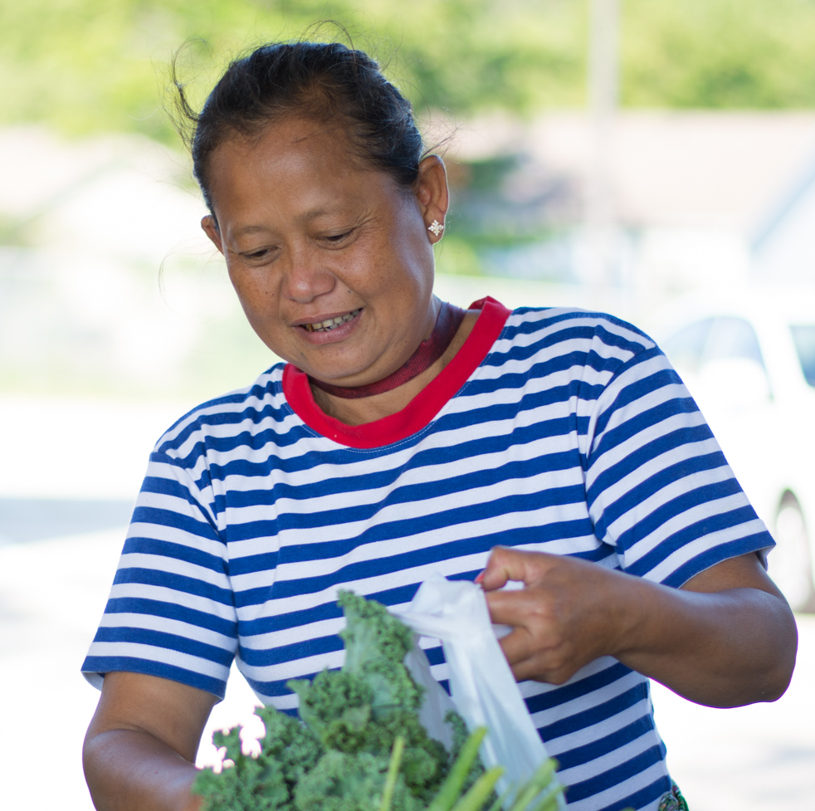
2023 Farm Bill
Broad Policy Landscape
Razor thin margins in House (R) and Senate (D)
Debt ceiling and budget negotiations (X date)
Work requirements and SNAP
2024 presidential election

Slide 5
2023 Farm Bill
Farm Bill Landscape
New funding for any program a challenge
SNAP spending increases under close scrutiny (COVID and Thrifty Food Plan)
Commitments to complete farm bill this year
Agriculture community stressing need to support strong nutrition title

Slide 6
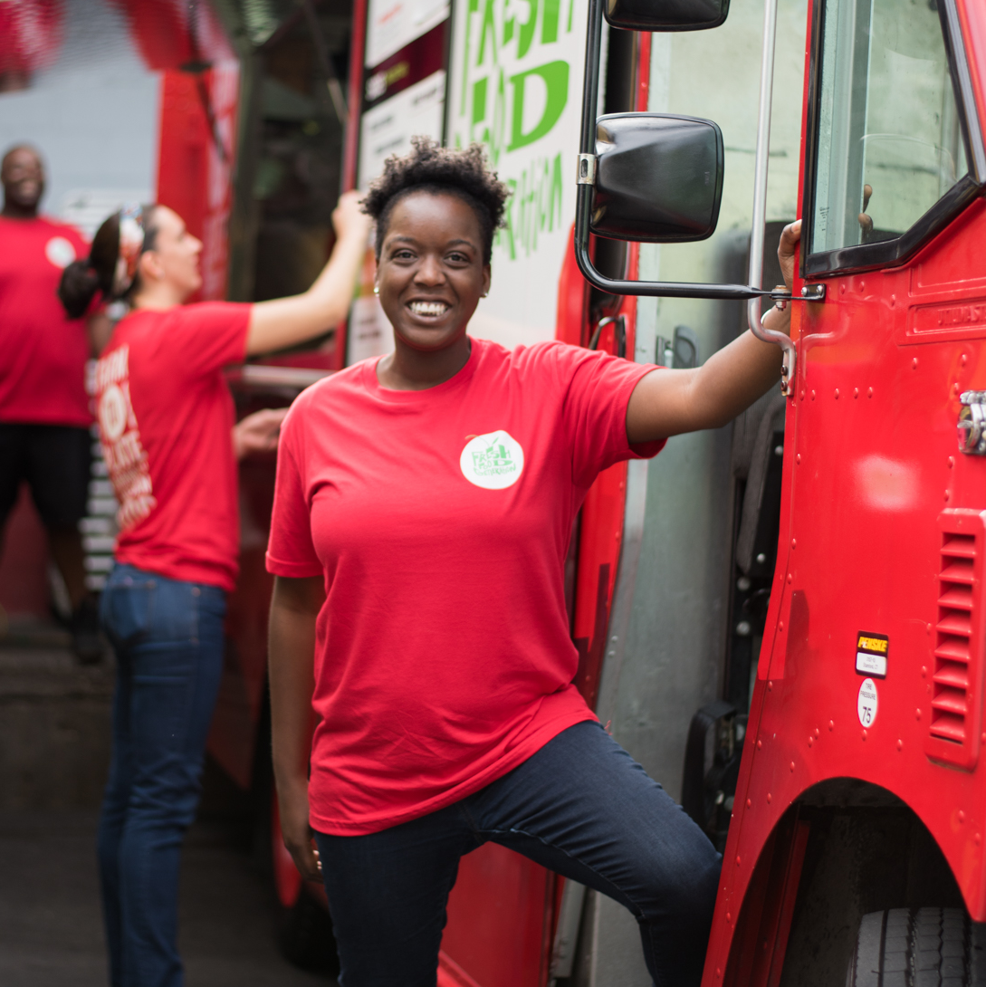
Alliance for National Nutrition Incentives
ANNI is a collective of national stakeholders seeking to advance common priorities for the Gus Schumacher Nutrition Incentive Program (GusNIP) in the 2023 farm bill. We will work through open dialogue and collaboration to identify areas of mutual agreement that we can advance together.
Academy of Nutrition and Dietetics
American Heart Association
Bread for the World
Center For Science in The Public Interest
Fair Food Network
Farmers Market Coalition
International Fresh Produce Association
National Grocers Association
National Produce Prescription Collaborative
National Sustainable Agriculture Coalition
Save the Children
Union of Concerned Scientist
Wholesome Wave
Grantees in AR, CA, CO,
HI, IA, NY, OK, OR, RI

Slide 7
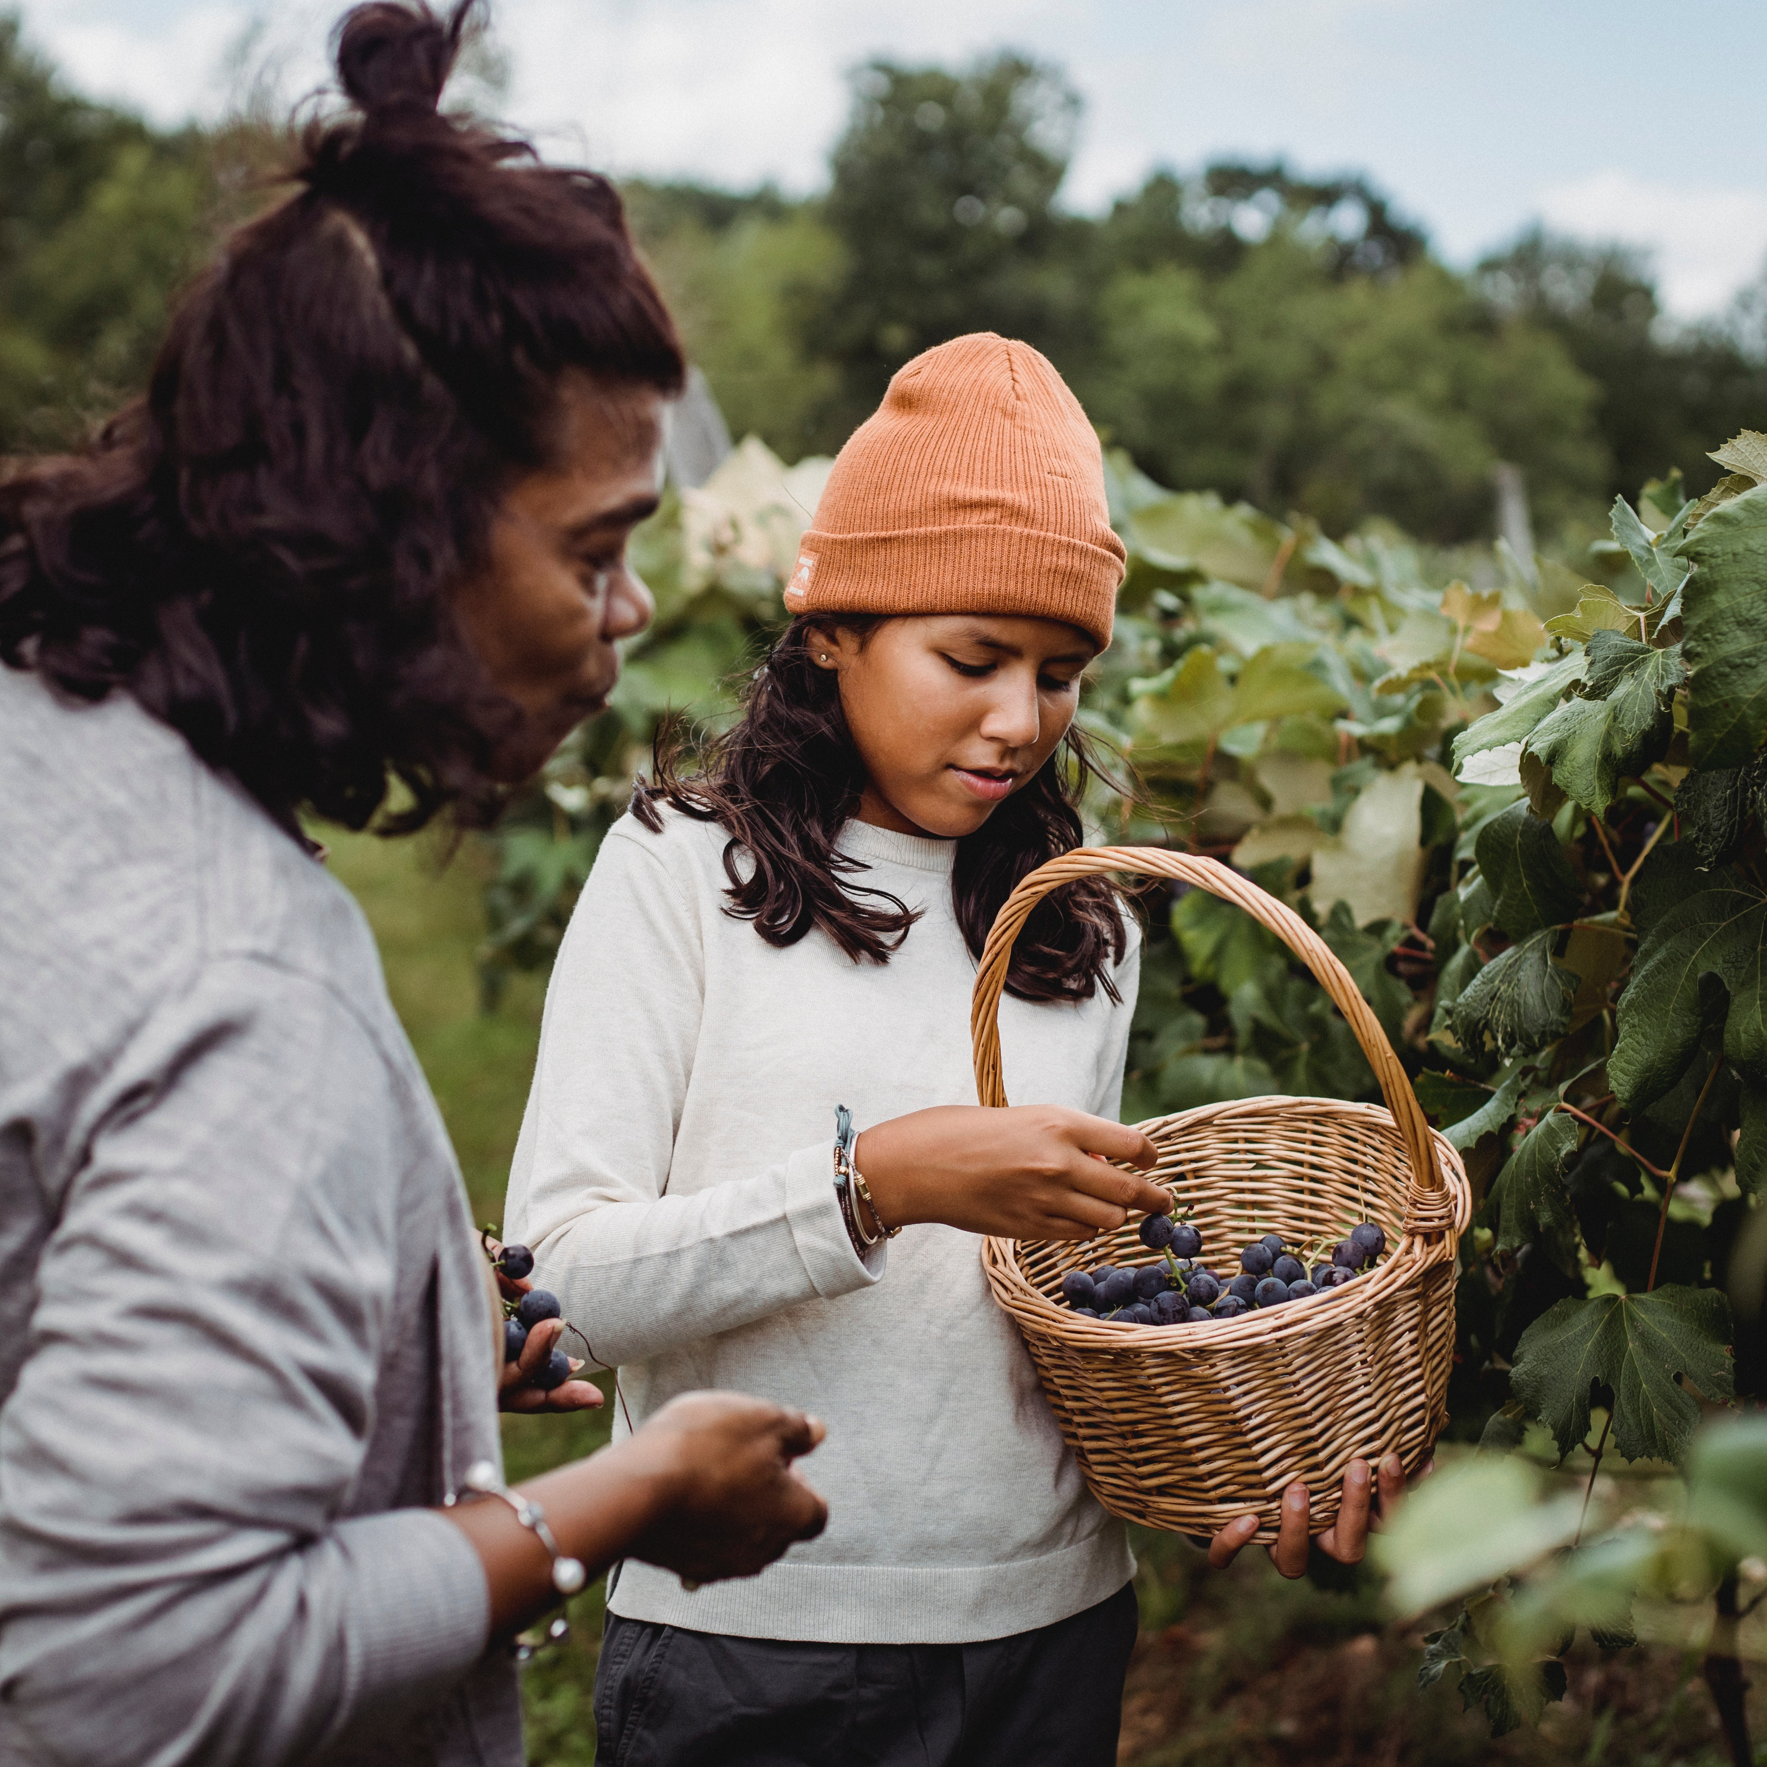
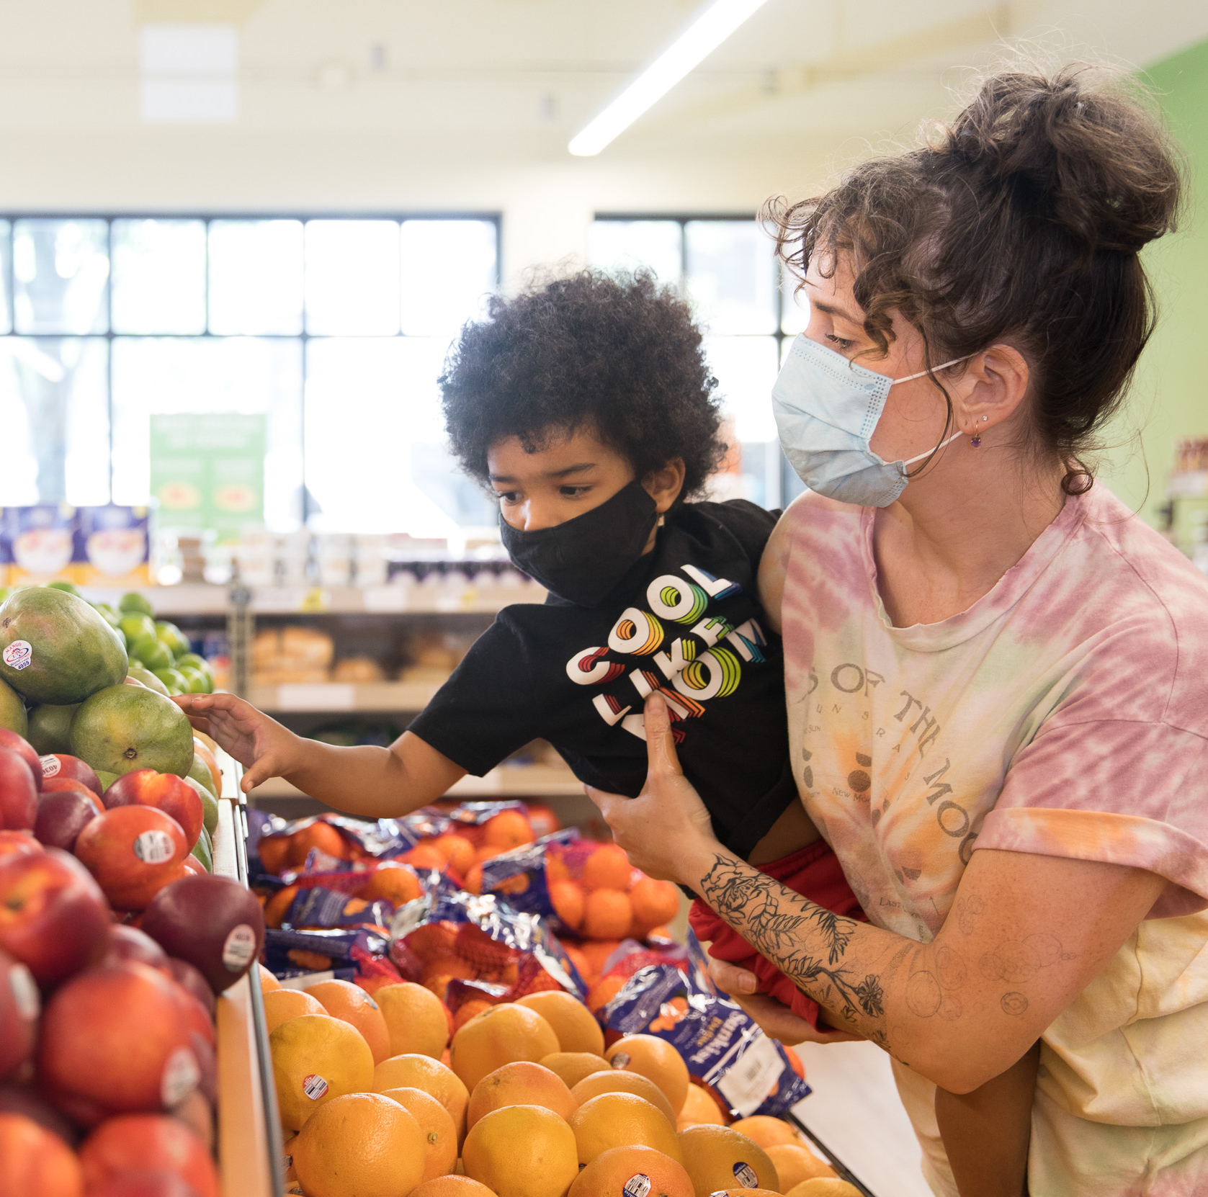
GusNIP Farm Bill Priorities
Funding to scale broad impacts
Eliminate/reduce non-federal match
Create a new USDA grant tier for statewide expansion
Renew commitment to local producers and independent grocers

Slide 8
GusNIP Farm Bill Strategy
Strategy
Strategic guidance (Torrey Advisory Group)
Bi-partisan marker bills (May?)
Broad stakeholder support (sign-on letter)
Grassroots advocacy (June 6-8 convening)
July farm bill drafting
Conference committee (Dec?)

Slide 9
Future
Funding Opportunities
Extended farm bill campaign
Continuing ANNI through implementation
Laying the foundation for the next farm bill

Slide 10
THANK
YOU

