Slide 1
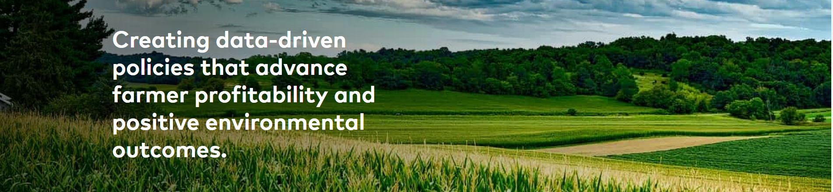
August 2023

Slide 2
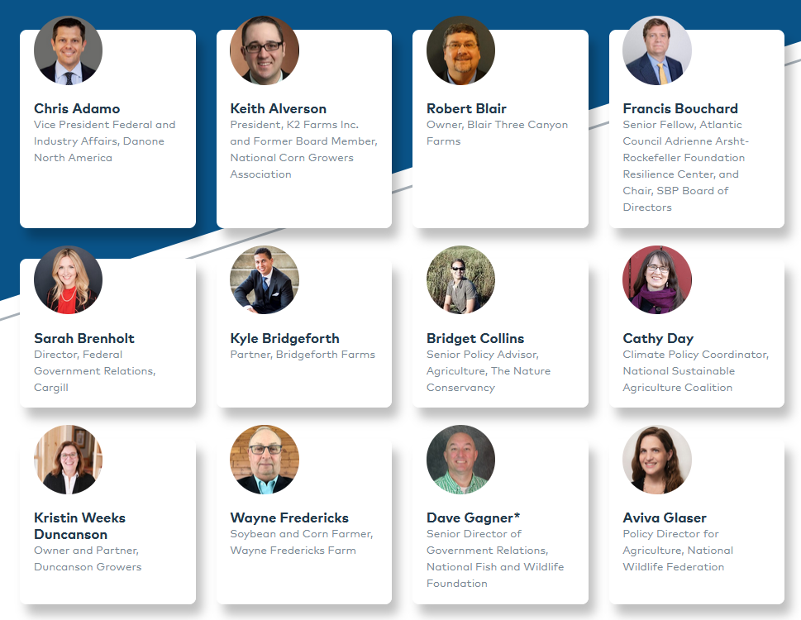
Coalition Members
Representing a diverse range of interests, our members include researchers, food companies, conservation groups, academics, farmers, and former officers of the U.S. Department of Agriculture (USDA).

Slide 3
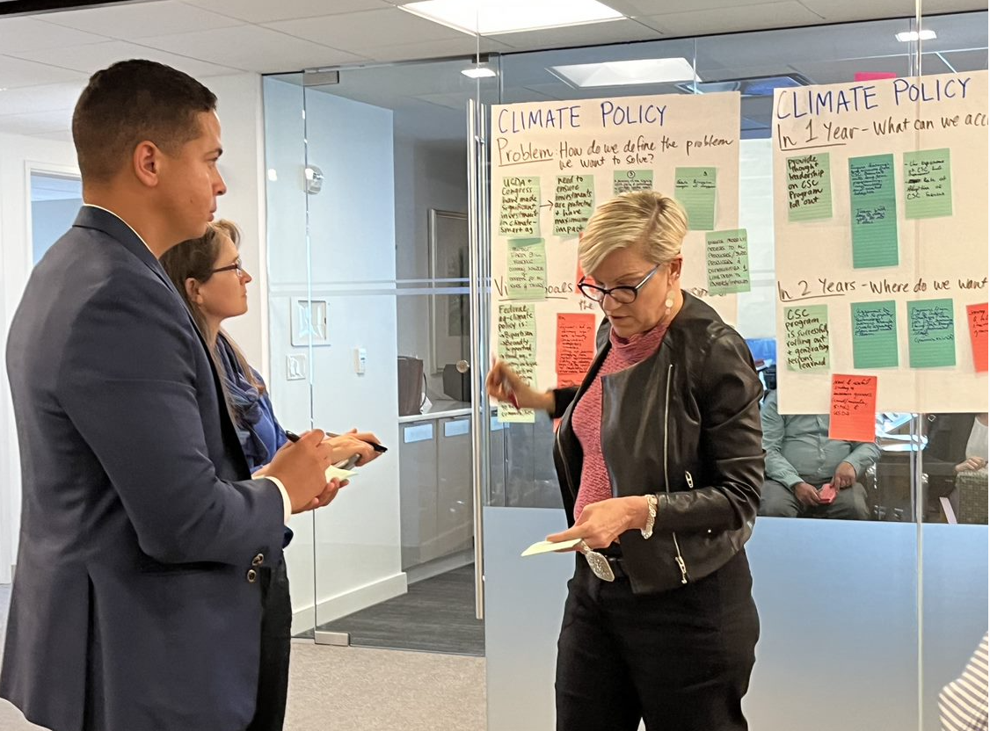
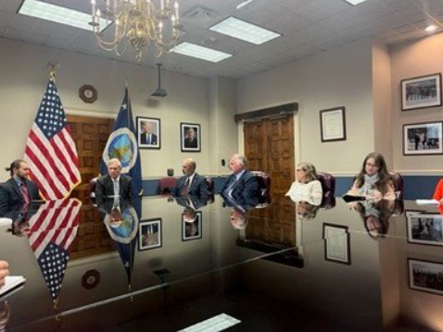
We make the argument that adoption of conservation practices is a win-win for farmers and society through:
Facilitating Bipartisan Dialogue
Developing and Advocating for Federal Policy Recommendations
Conducting Pilots

Slide 4
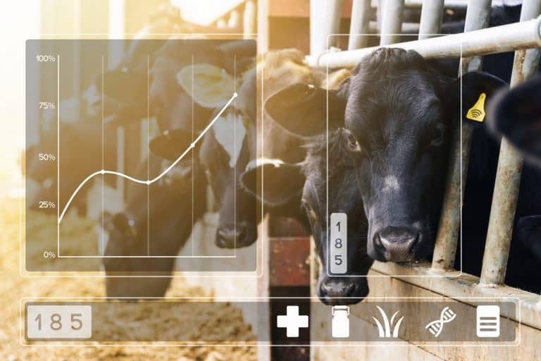
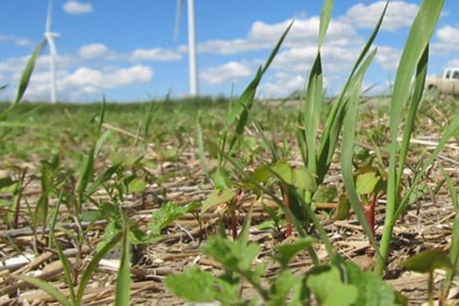
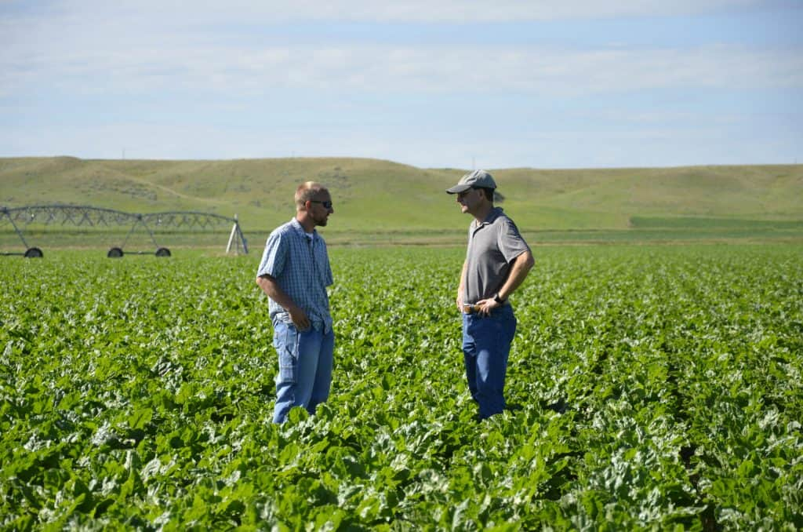
AGree’s 2023 Farm Bill Policy Platform
AGRICULTURE DATA
CROP INSURANCE
AGRICULTURE FINANCE
CLIMATE SMART COMMODITIES
TECHNICAL ASSISTANCE

Slide 5
Agriculture Data and Research
Better use of agricultural data is critical to helping farmers and ranchers increase their productivity, profitability, and environmental performance.
POLICY RECOMMENDATIONS
Agriculture Innovation Act
Direct USDA to conduct additional pilot projects to answer critical questions about the environmental impacts of different farming systems.
Expand data collection on diversified systems.
Invest in research to build the business case for climate-smart ag and improve climate models and measurements.

Slide 6
Crop Insurance
Removing barriers to conservation adoption and improving risk management tools for transitioning to conservation practices and diversified systems would strengthen the Federal Crop Insurance Program.
POLICY RECOMMENDATIONS
Create a Farmer Innovation Transition Program to manage financial risks associated with conservation adoption and innovation.
Eliminate remaining barriers to adoption of conservation within the FCIP
Conduct a comprehensive review of Whole Farm Revenue Protection (WFRP) and execute improvements.

Slide 7
Developing New Crop Insurance Products
We are working to expand availability of risk management tools that support adoption of conservation practices that are proven to reduce agricultural risk.
The 508(h) process
The Post-Application Coverage Endorsement (PACE).
Other conservation-focused products are currently in development.

Slide 8
Agriculture Finance
Policy action can build understanding of the financial risks of climate change and incentivize finance providers to incorporate the benefits of conservation into investment and lending practices.
POLICY RECOMMENDATIONS
Establish the Center for Conservation Economics to coordinate farm financial benchmarking efforts focused on economic analysis of conservation practices across states.
Develop a multi-year developmental loan pilot to provide flexible and bundled financing options that help beginning farmers and ranchers grow equity in operations to support long term success.

Slide 9
Technical Assistance
Current demand for conservation technical assistance exceeds existing capacity. There are opportunities to expand innovation and increase availability of technical assistance.
POLICY RECOMMENDATIONS
Conduct a comprehensive stakeholder engagement and analysis process to understand how federally funded technical assistance can meet the needs of a diverse array of stakeholders and regionally specific needs.
Design, pilot, and scale innovative projects that demonstrate how the nation’s technical assistance system could be reimagined at scale.

Slide 10
Climate-Smart Commodities
It is crucial to take advantage of the historic investment in conservation by ensuring the success of the Climate-Smart Commodities program.
GUIDING PRINCIPLES TO INFORM IMPLEMENTATION
Promote Innovation
Measure Outcomes
Ensure Access
Facilitate Research
Utilize Financial and Risk Management Incentives
Invest in Technical Assistance

Slide 11
Climate-Smart Commodities Network Map
climatesmart.merid.org
An interactive map and visual representation of the connections between Partnerships for Climate-Smart Commodities program.
The map visualizes:
How are projects distributed across commodities?
Which organizations are driving these projects? How are organizations engaged across projects?
What target practices are projects focusing on?

Slide 12
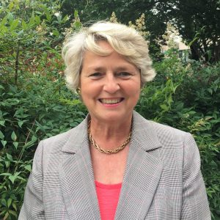
Contact Us
Questions?
Follow Our Work
Deborah Atwood
Senior Fellow
Datwood@merid.org
foodandagpolicy.org
Madelyn Smith
Mediator & Program Manager
msmith@merid.org
@AGreeAgPolicy

